Slide 1
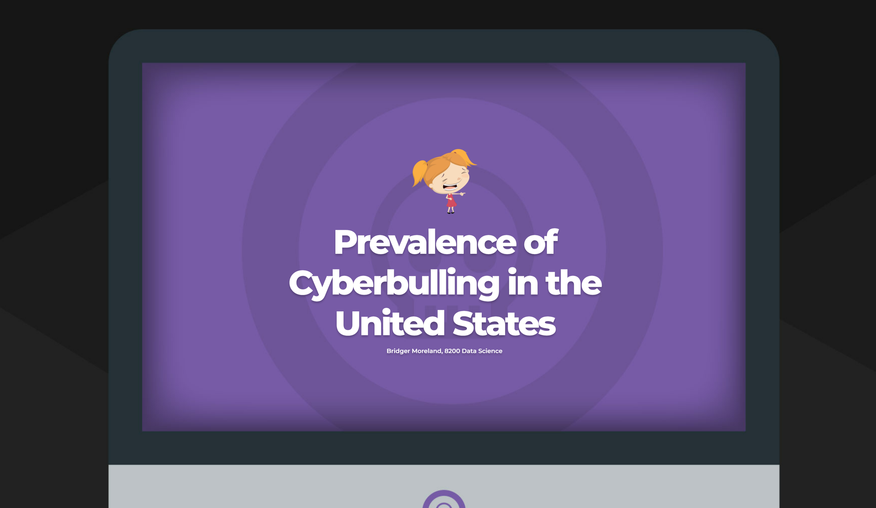

Slide 2
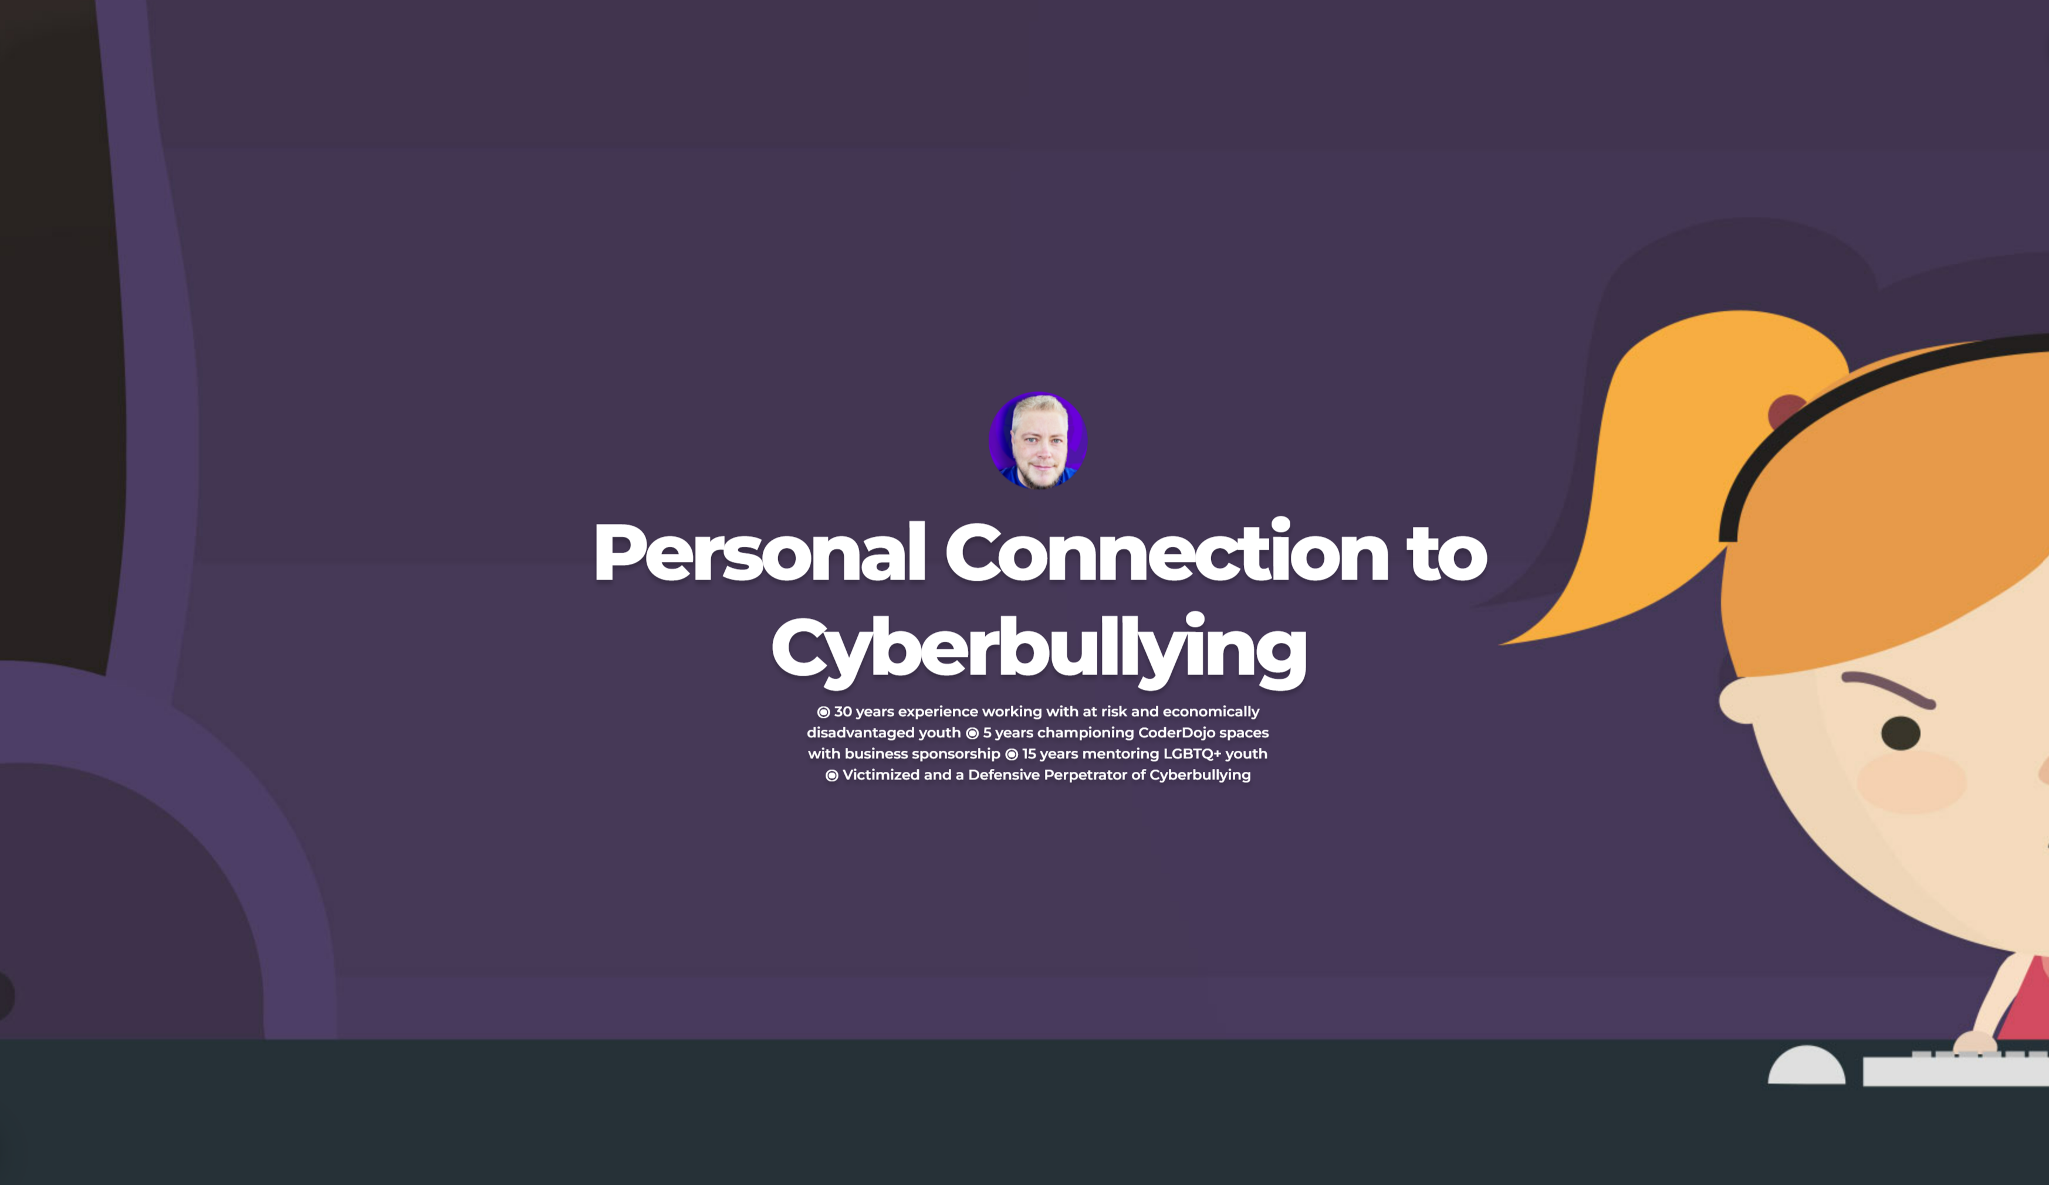
Notes:
The highest reported age range for harassment by cyberbullying is among 12 to 18-year-olds, the age 6 of our grandchildren happen to be. Given the statistics we are about to cover, and the amount of time they are plugged in to online platforms, it does not leave much hope that it isn’t happening to them. Aside from that sobering realization, for over 30 years I have maintained a connection through volunteer work helping to find opportunities for at risk youth. The last five were spent championing the CoderDojo movement, which promotes experimentation and learning through technology. These are spaces where it is imperative to squelch the harassing behaviors I have seen occur. The whole purpose of that program is to provide safe, inclusive environments for kids who are often stereotyped away from STEM programs. This extends especially to LGBT+ youth who have an increased likelihood of being victimized through cyberbullying. Being part of their world, it is as personal of an issue as it is with my grandchildren. Finally, like many in the US, I have been a target of this form of harassment. Sadly, I can also say that I have on one occasion been a defensive cyberbully myself acting out in retaliation.

Slide 3

48
States with Laws Against Cyberbullying
48
States with Laws Against Cyberbullying
48
States with Laws Against Cyberbullying
Notes:
The first problem to address is the definition of this problem. Cyberbullying is one of those conditions that we all know when observe it. But can be hard to define. For severe behaviors it can fall within a legal definition for classification certainty. For other occurrences, it can be damaging to one victim and perceived as harmless to another. There are subtleties in the spectrum on what is considered by some to be acceptable verses bullying behavior. Like most very personalized crimes, there are also high levels of shame ,embarrassment, or fear that prevents many from reporting the behaviors. It is a growing problem, with cyberbullying has surpassing other forms of bullying as the most common type of harassment that middle school and high school students experience. In the efforts to create safer online spaces, many large organizations and research groups have problems even creating a dataset to detect cyberbullying so that they can find a way to intervene. The datasets are huge, difficult to collect, subject to interpretation, specific to language and regional dialects, and expensive to house and maintain. This is big data with high overhead needs. As with most crimes, the lack of black and white categorization often leaves to underreporting and adds to the already difficult task of even measuring the severity of this problem in the US. While all states have various criminal laws that might apply to bullying behaviors, depending on the nature of the act, current legislation wins highlight the severity of cyberbullying in America. Since 2007, all but 2 states now specifically call out cyberbullying or some form of online harassment.

Slide 4
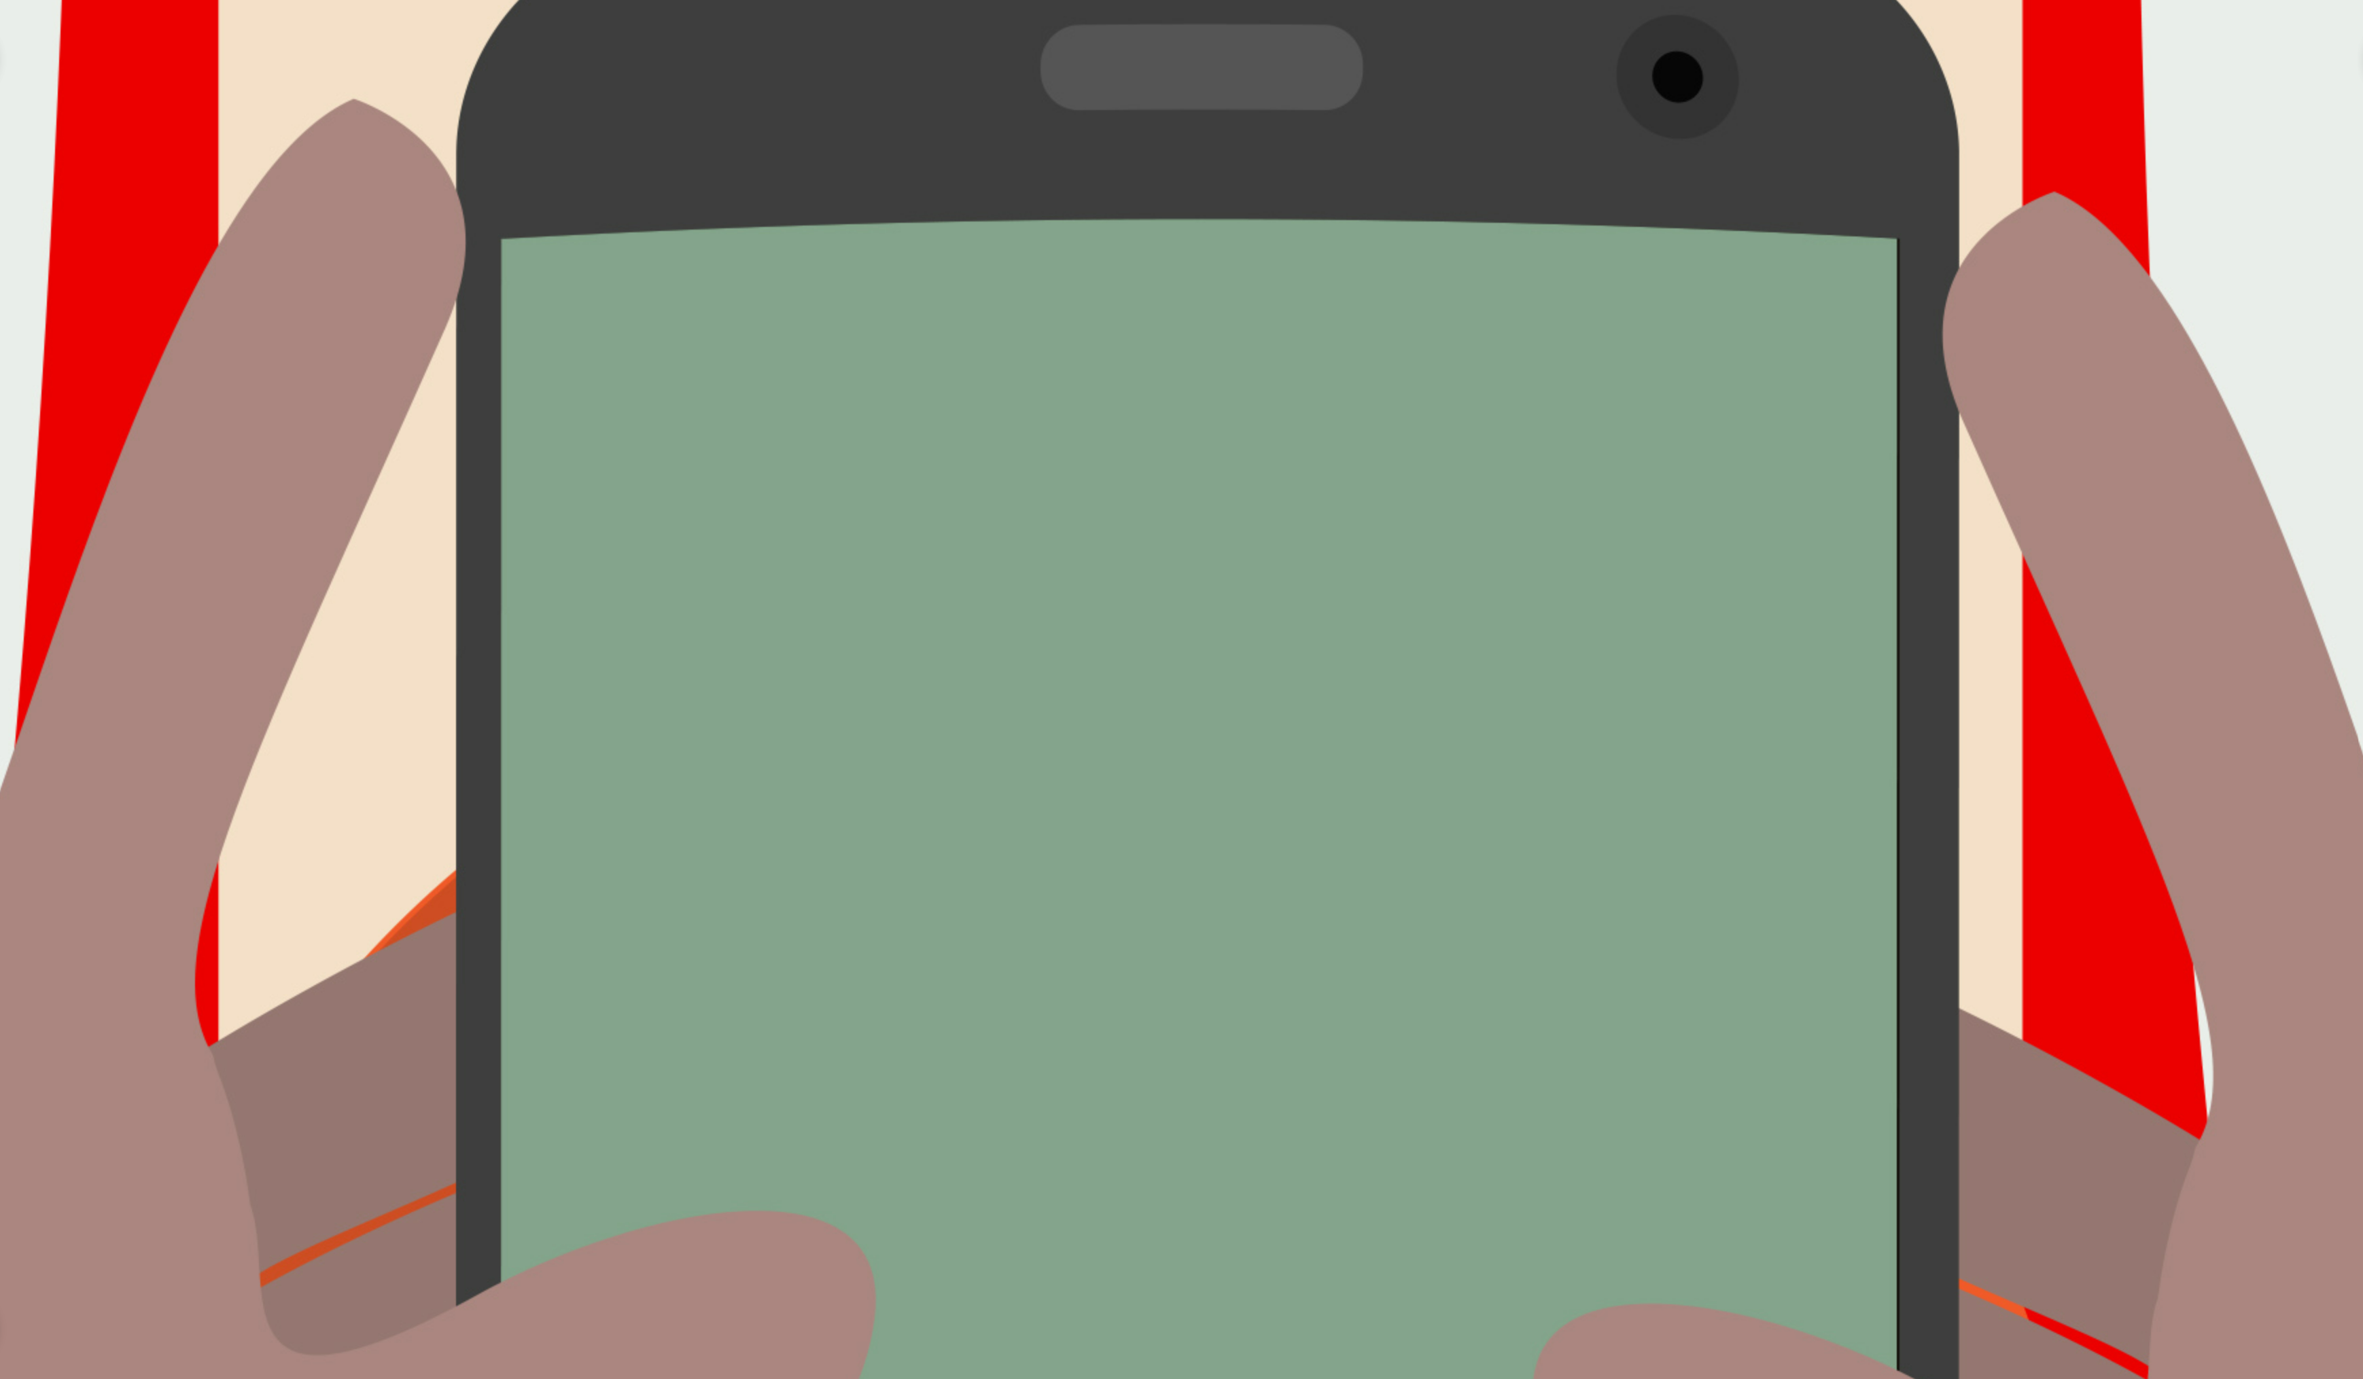
59% of U.S. teens have experienced cyberbullying
63% say this is a major problem
25% of teens say they received unwanted explicit images
Pew Research Center, 2018
Notes:
According to Pew Research Center, who has conducted numerous studies on the subject, 59 % of US teens have experienced cyberbullying. 90% say it is a problem. But 63% qualify it as a major problem that parents, school officials, teachers, and government are not doing enough to remedy.

Slide 5
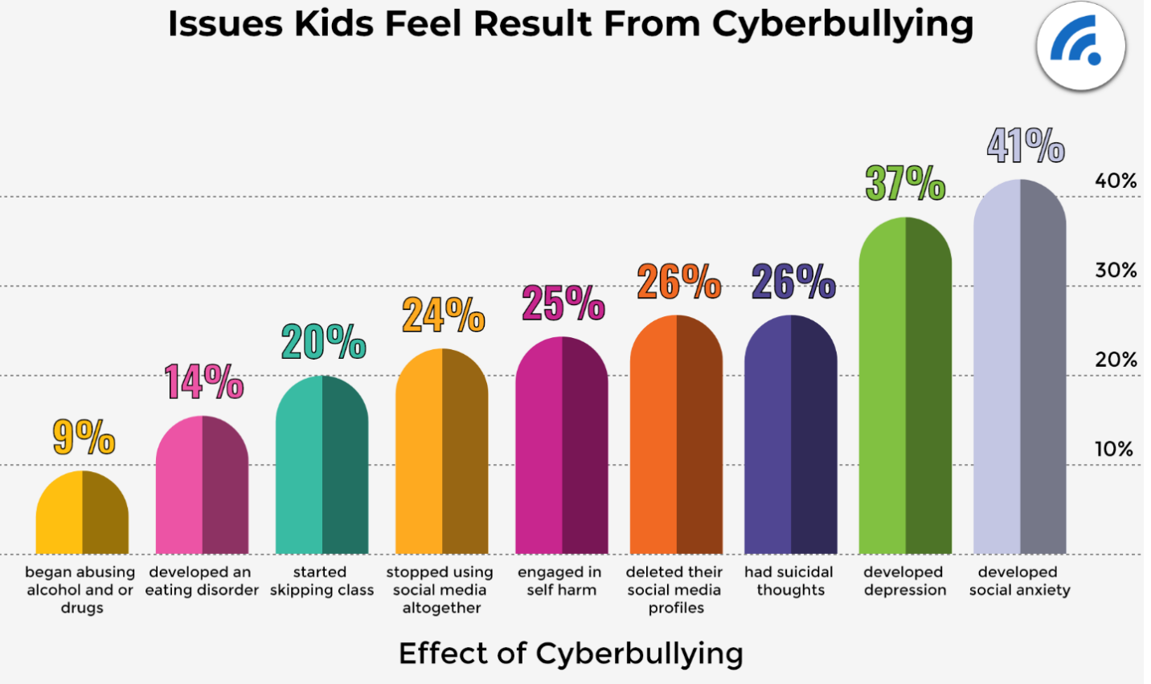
BroadbandSearch.com, 2022
Notes:
Verifiable datasets around cyberbullying and its effects are not easy to assess. Question wording and practical difficulties in conducting surveys can introduce error or bias into the findings before modeling even begins. Even the frequency of a victim being online without collecting that datapoint can skew the results. The more kids are online, the more opportunity for cyberbullying to occur. For the most severe of these issues, studies do find a correlation between bullying and suicide. Overall, they suffer from methodological limitations due to both the survey collection for a single point in time and the sensitivity the questions pose the participants. Many studies also fail to control for other factors known to be related to suicide. As skewed as the data may be, there is enough research to strongly suggest a link between cyberbullying and the mental and physical health of the victims.

Slide 6
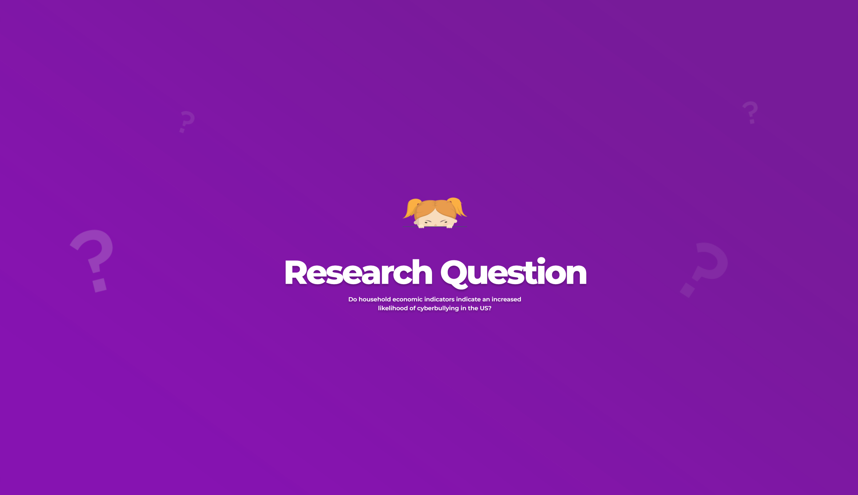
Research Question
Do household economic indicators (independent variable) indicate an increased likelihood of cyber bullying (dependent variable) in the US?
Notes:
According to Pew Research Center four in ten Americans have battled online abuse in some form, often escalating to more severe behaviors such as stalking and sexual harassment. Difficulties arise in quantitative measurements for identifying bullying behaviors and collecting data on their frequencies in given populations as there is no set definition of "Cyber Bullying". Researchers must rely on self-reported data from respondents, each with their own list of words and actions they perceive as an attack. Research has begun on identifying factors that influence harassment such as socioeconomic, ethnic, or other diversity criteria. In that vein, I attempted to assess the pressure points that increase the likely hood of becoming an online victim. My research question for this data analysis was "Do household economic indicators (independent variable) indicate an increased likelihood of cyber bullying (dependent variable) in the US?“
1 [@auxier_anderson_perrin_turner_2020]
2 [@national_crime_prevention_council_2022]

Slide 7
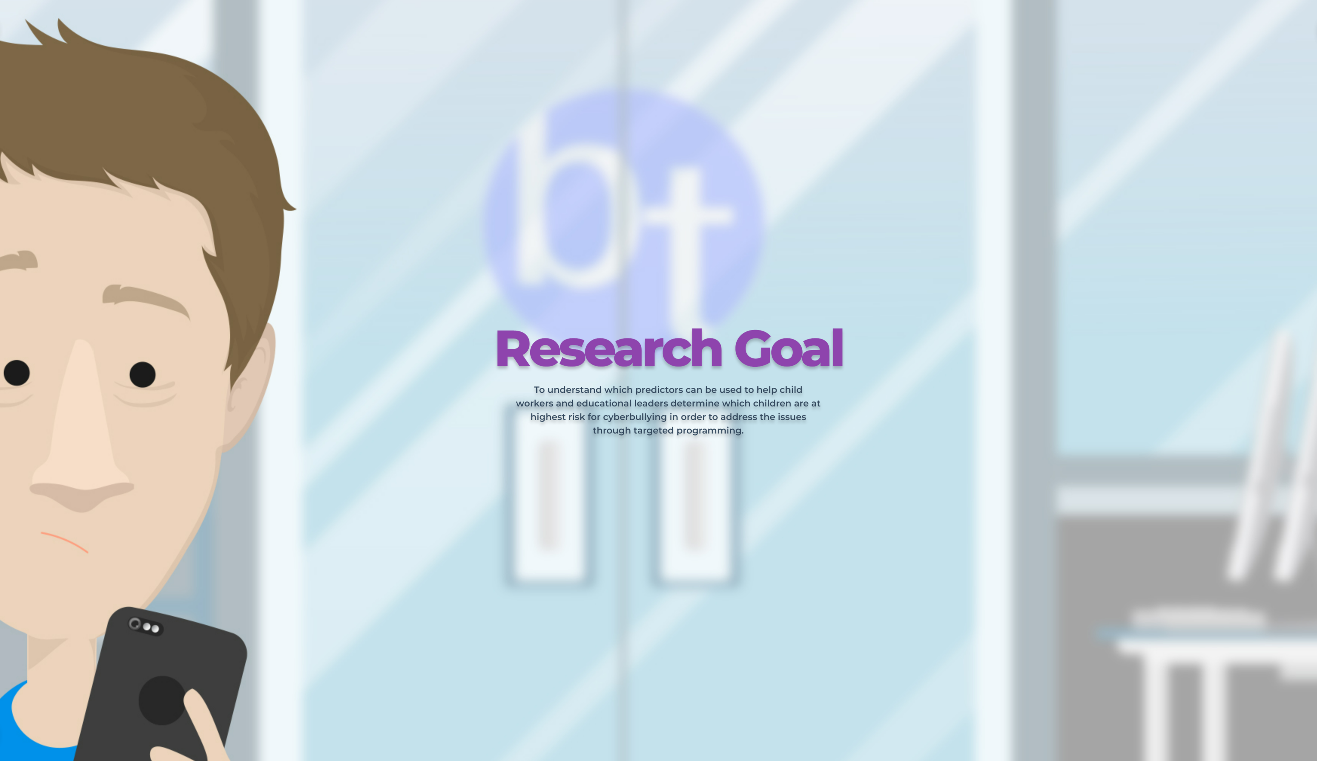
Notes:
Not to ignore the fact that adults are also victims of The goal of this research is to bring attention to the overwhelming numbers of individuals affected by this form of harassment. From this recognition, it is hoped that more programming will be built to cultivating resilience to prevent cyberbullying through intervention, new guidelines, empowerment for bystanders, and support for victims.

Slide 8
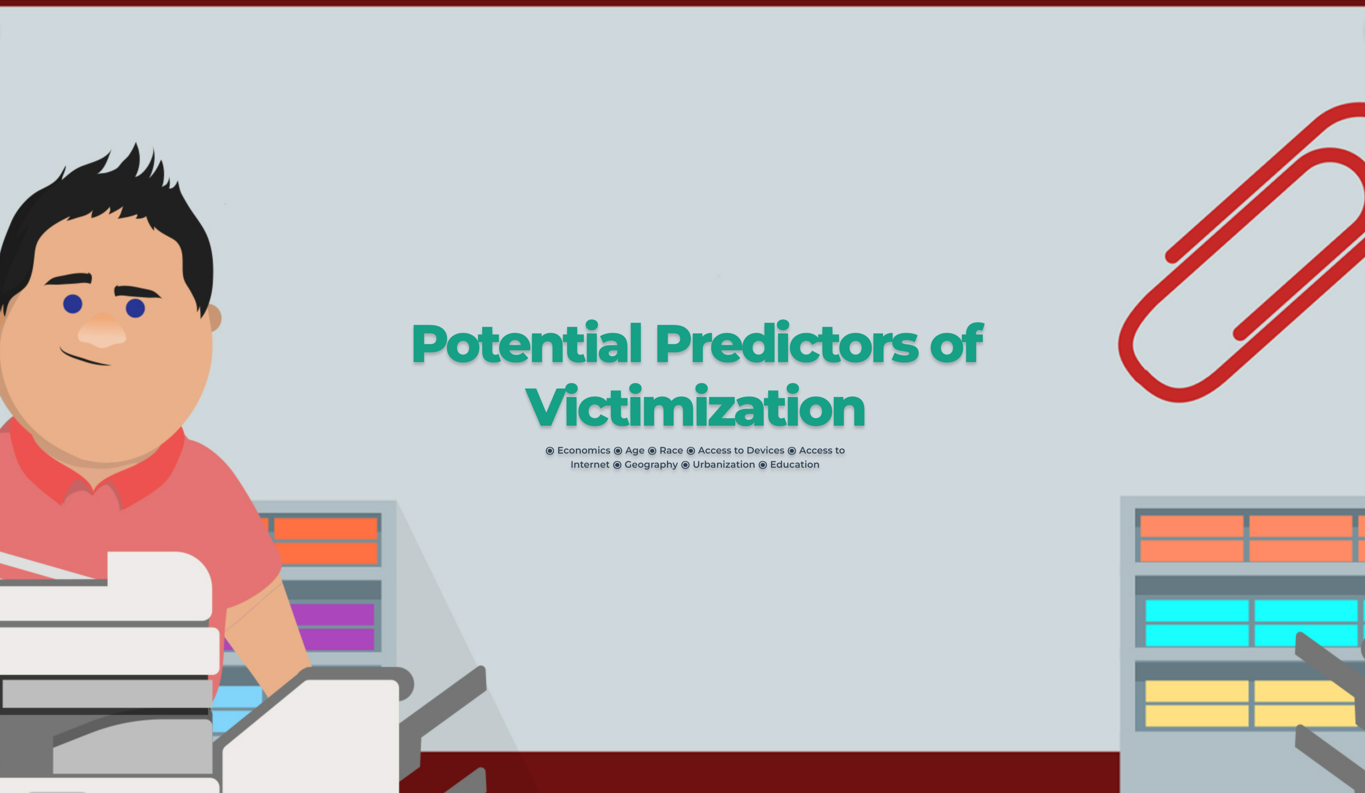

Slide 9

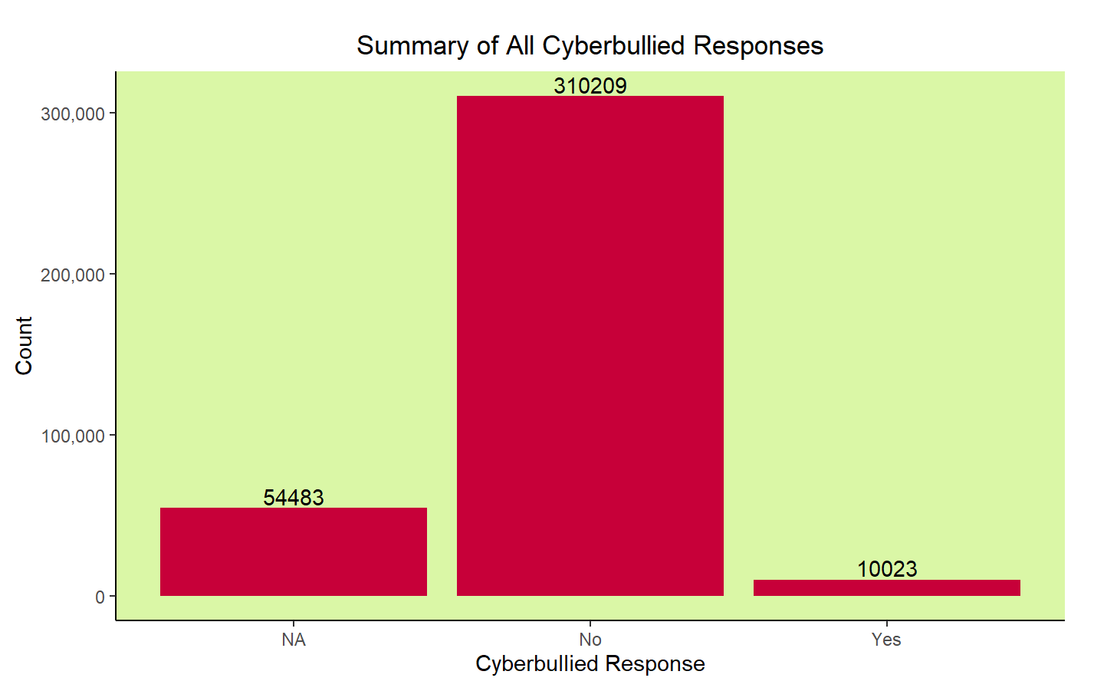
The Data
Notes:
For this effort I will be using a data set derived from the US Census Bureau where respondents were asked about online harassment, stalking, or cyber-bullying for any member of their household. Only three of their most current supplemental surveys address these specific data elements. Data was collected from the 2015, 2017, and 2019 versions of the Current Population Survey, Computer, and Internet Use Supplement. According to a summary of the raw results of our dependent variable, approximately 3.23% of respondents reported cyberbullying for someone in their household. This finding runs contrary to other studies with smaller subject pools that report much higher percentage of the population examined reported affirmatively they were subjected to cyberbullying. This does diminish confidence in reliability of our results due to the incongruities between the census survey data and the dozens of other studies on the topic performed within the same timeframes.

Slide 10
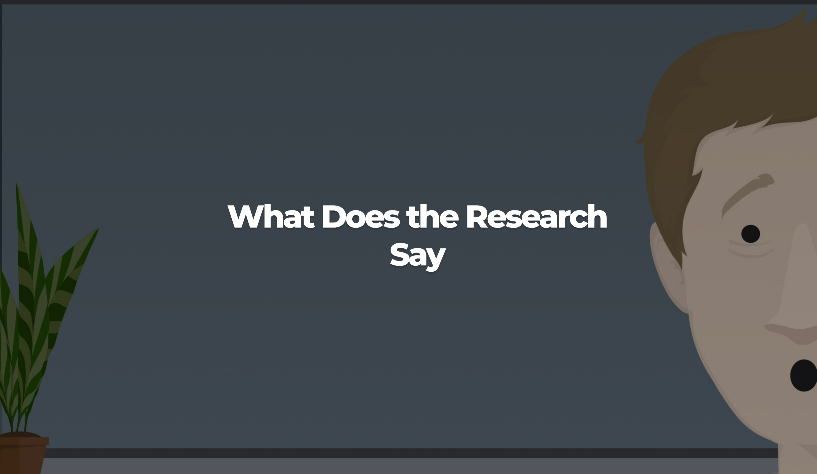
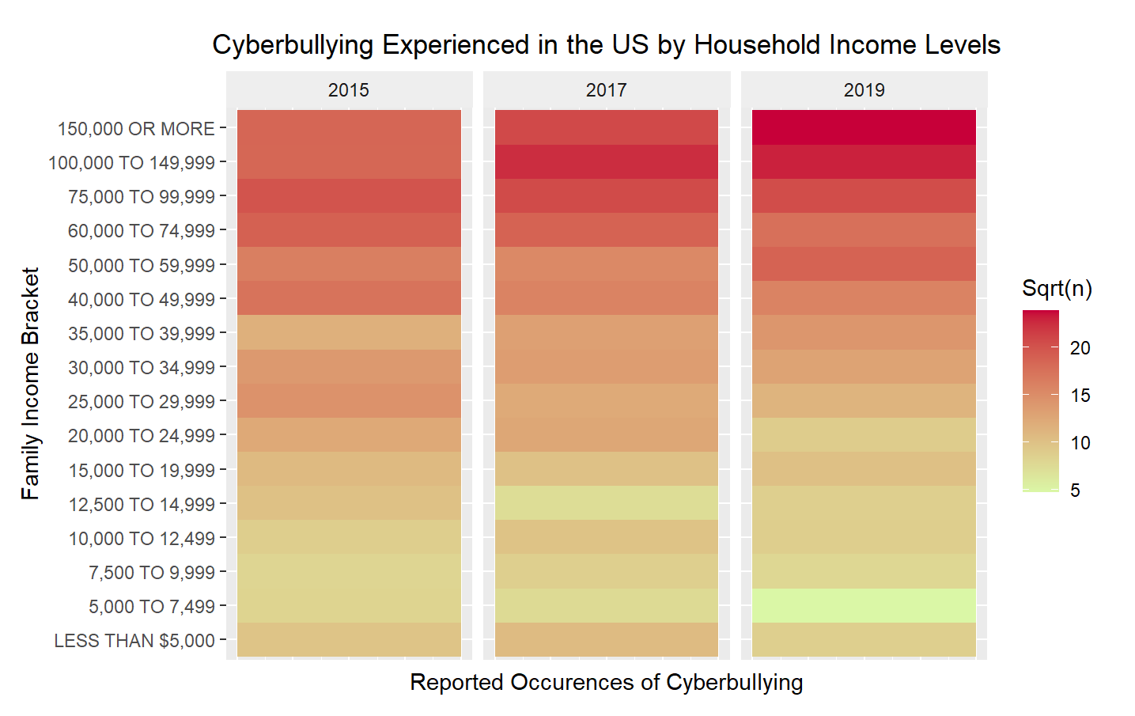

Slide 11
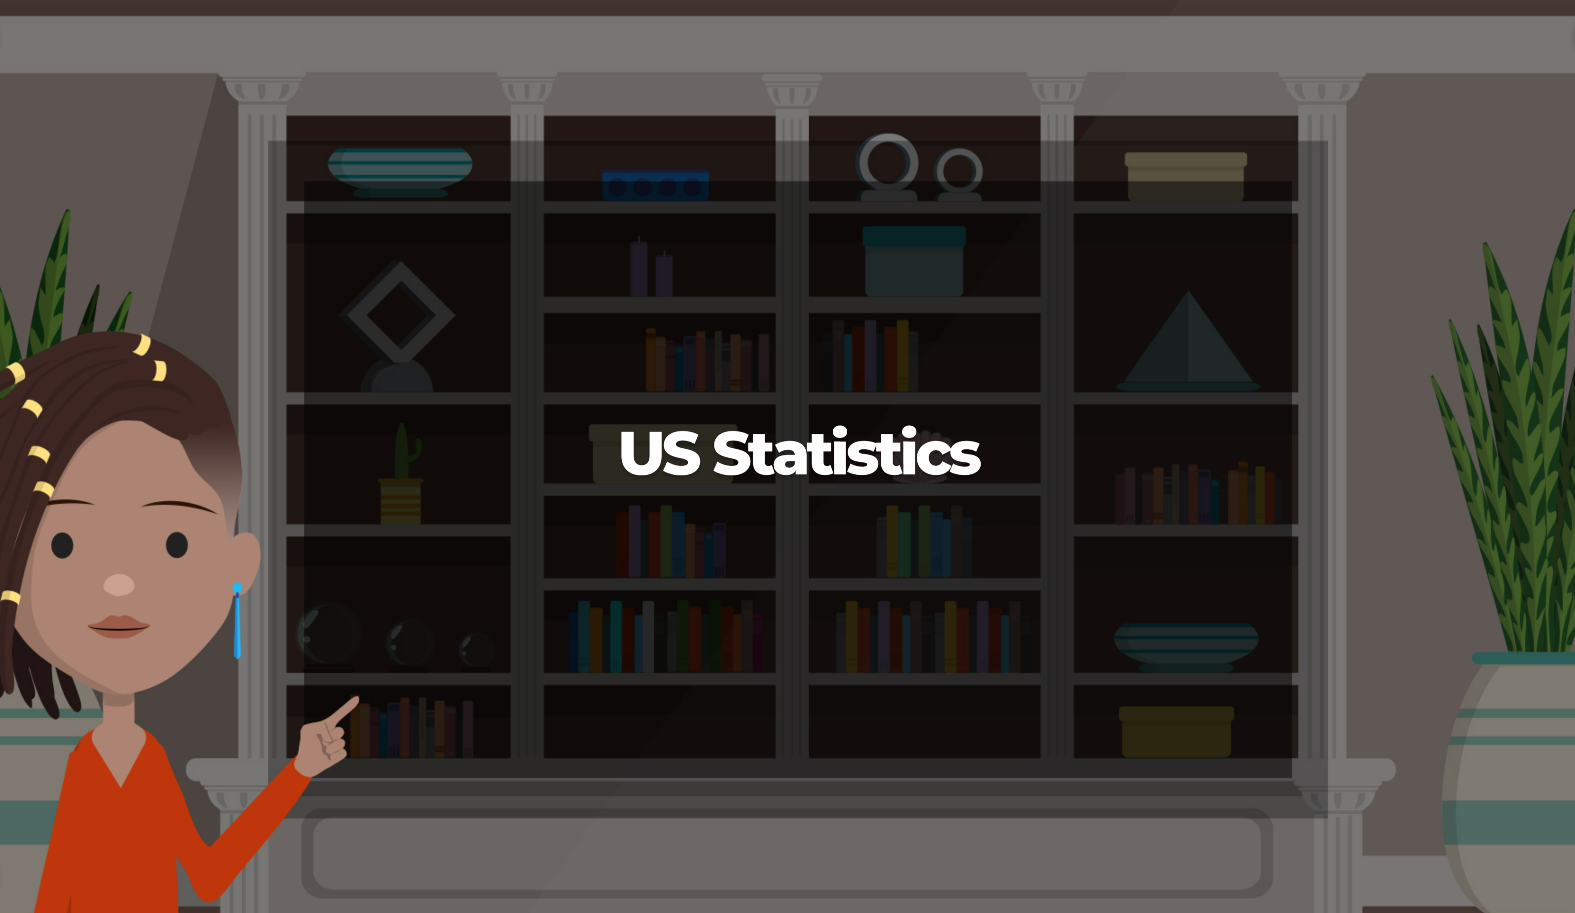
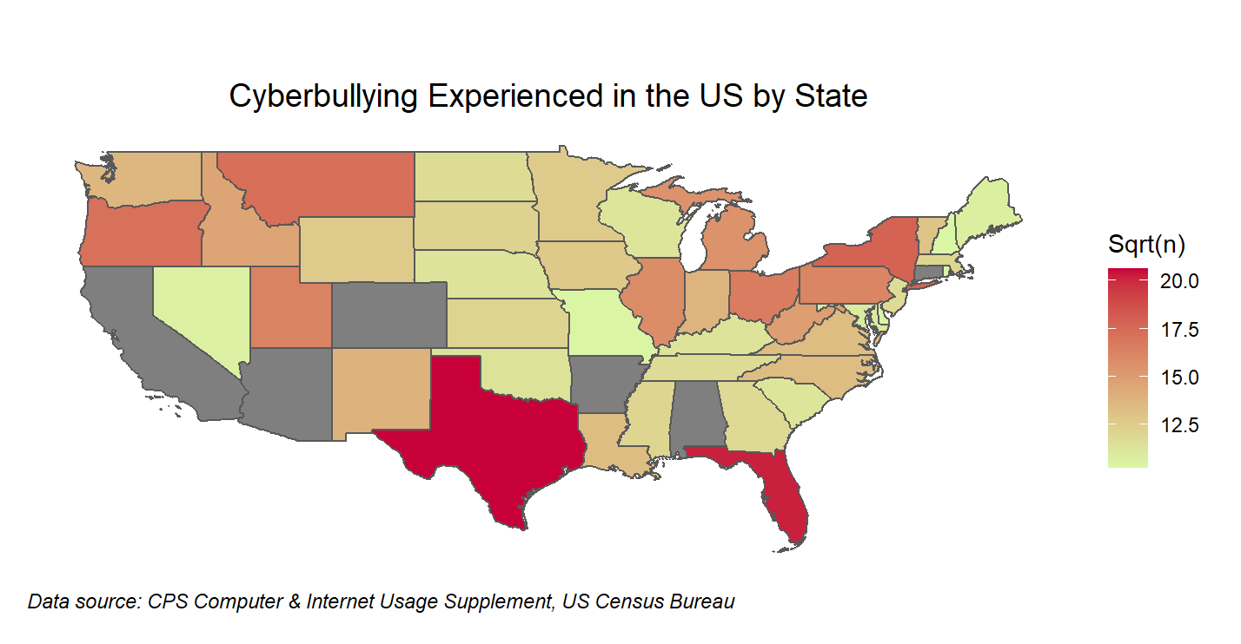
Notes:
While some states were missing from the data set from this supplemental survey, the majority of states with identified data was enough to suggest that geography could play a part in propensity for cyberbullying. After smoothing the data, Texas and Florida were high on occurrence, while Missouri, the first state to enact laws that specifically called out cyberbullying as a punishable office, ranked one of the lowest in likelihood to encounter cyberbullying.

Slide 12
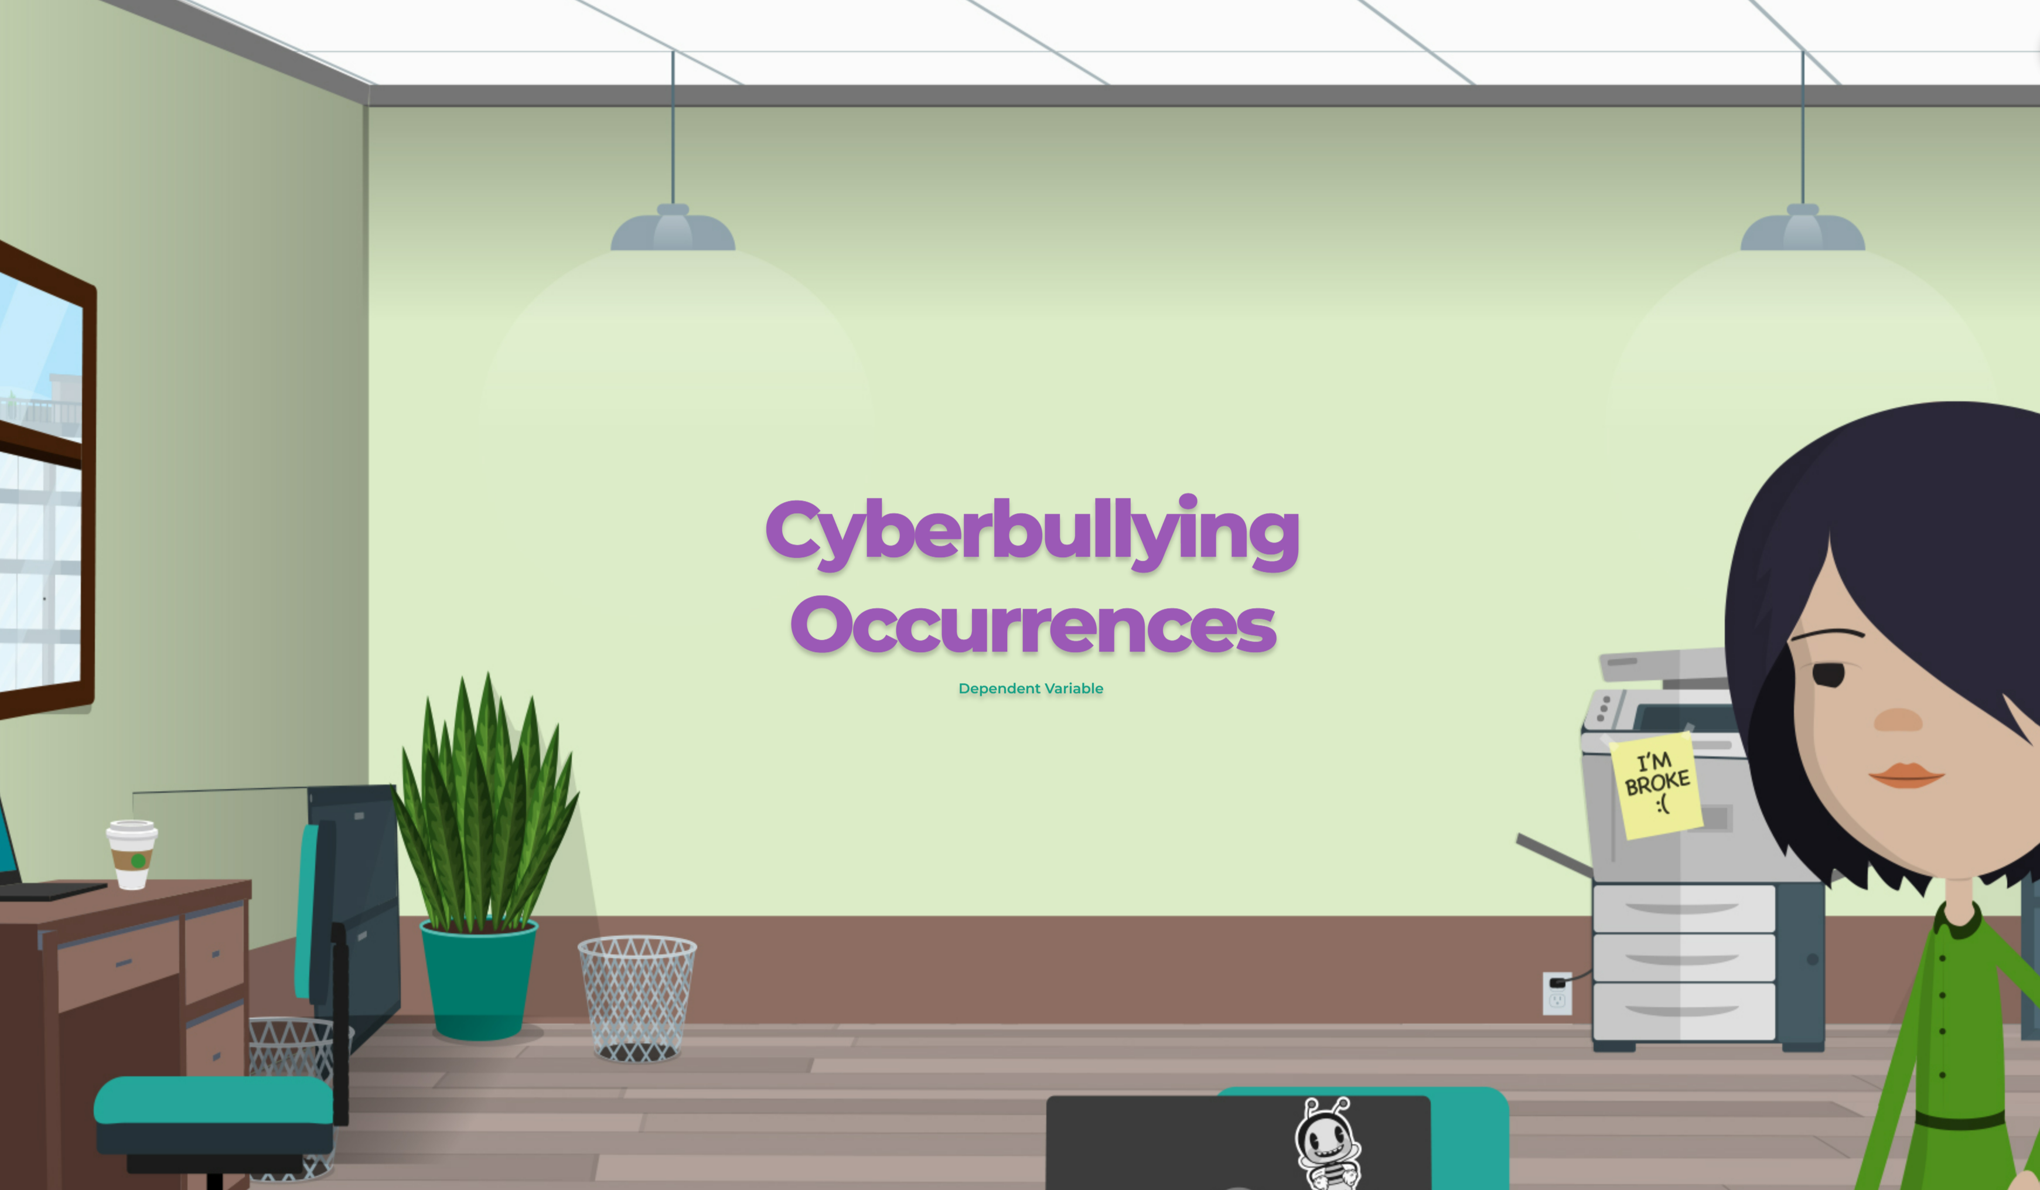
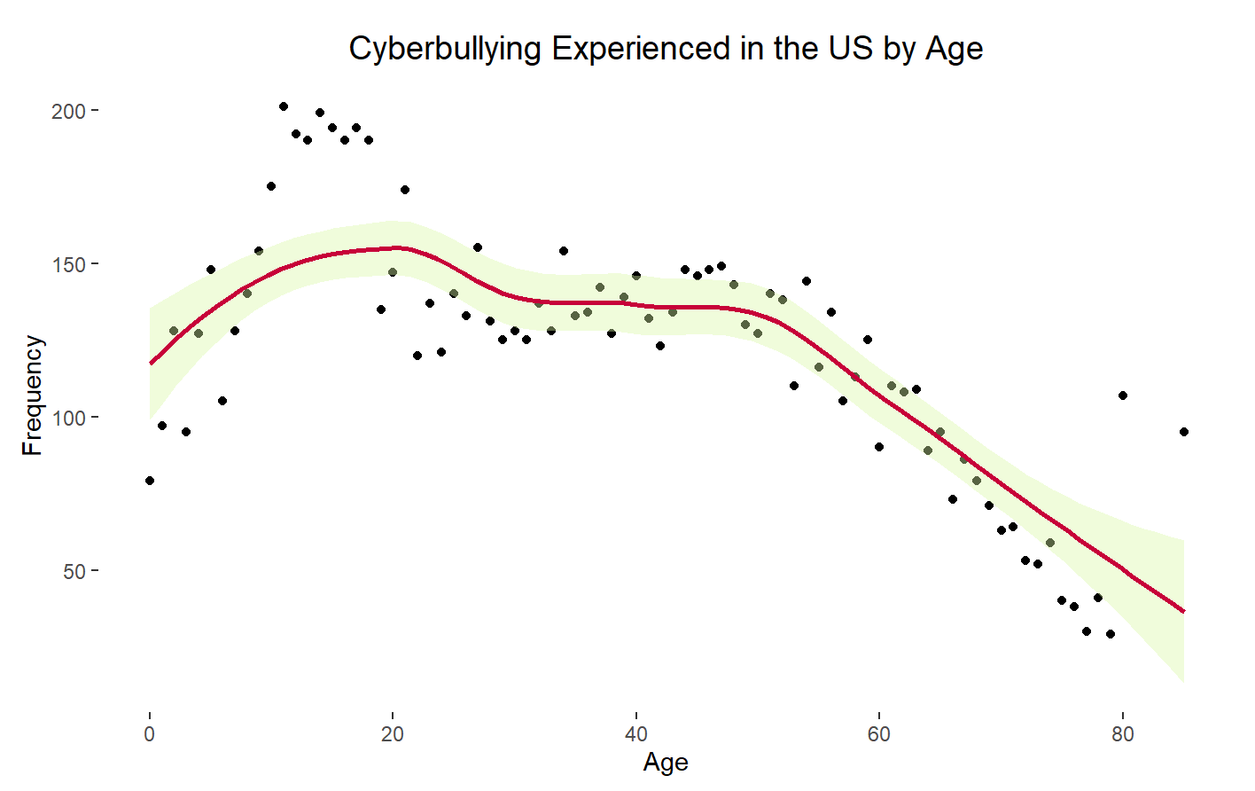

Slide 13

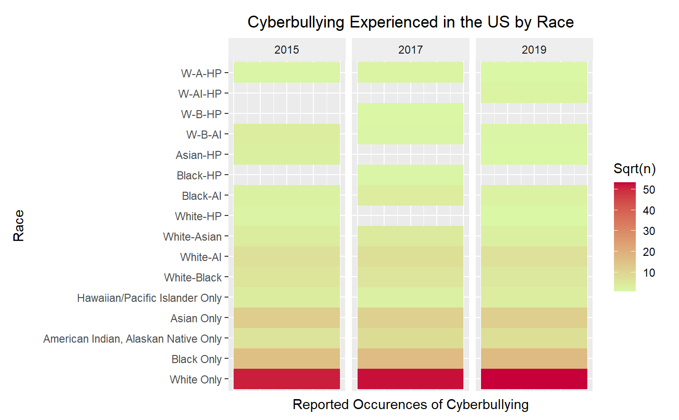

Slide 14

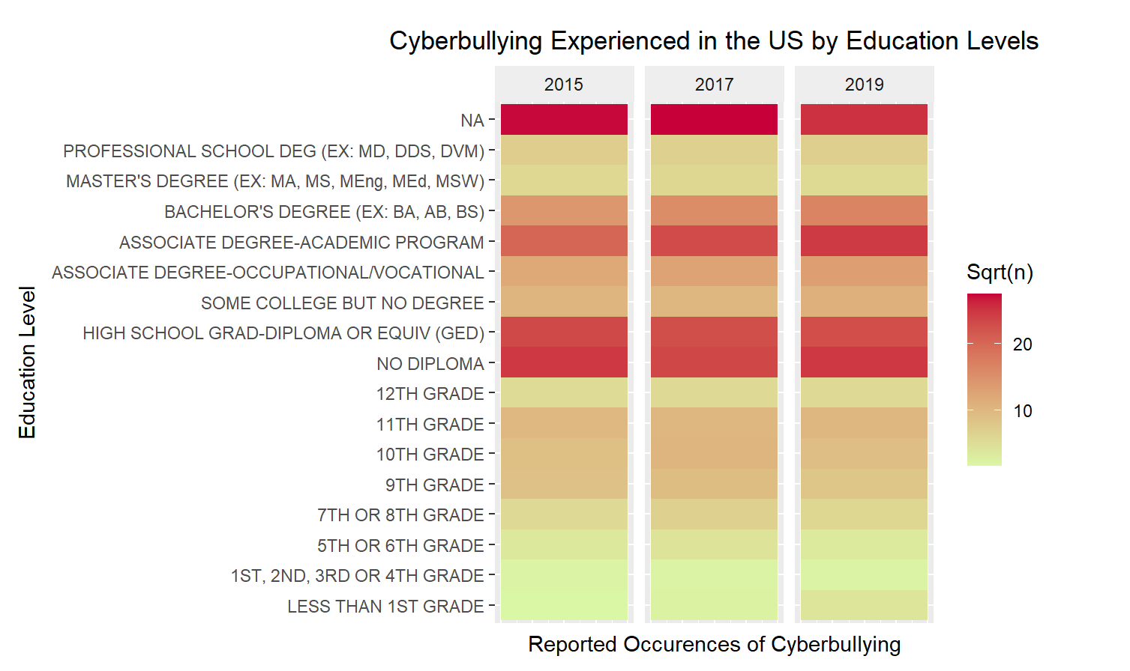

Slide 15

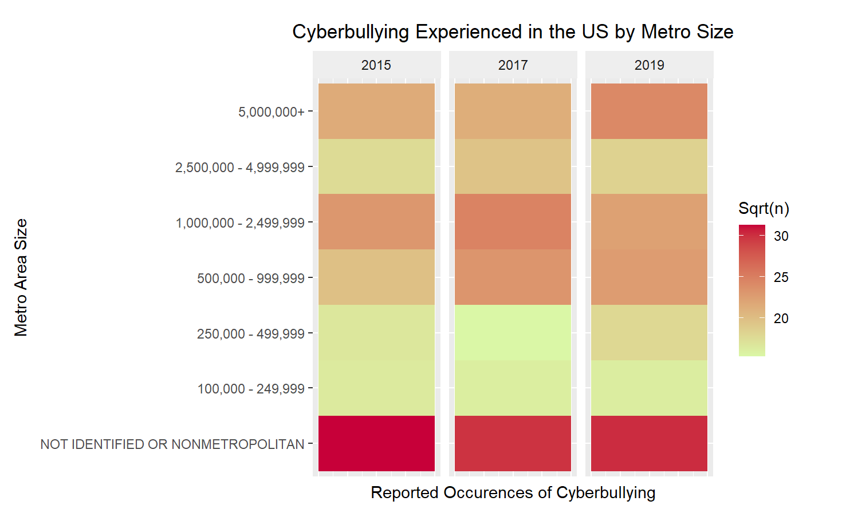

Slide 16

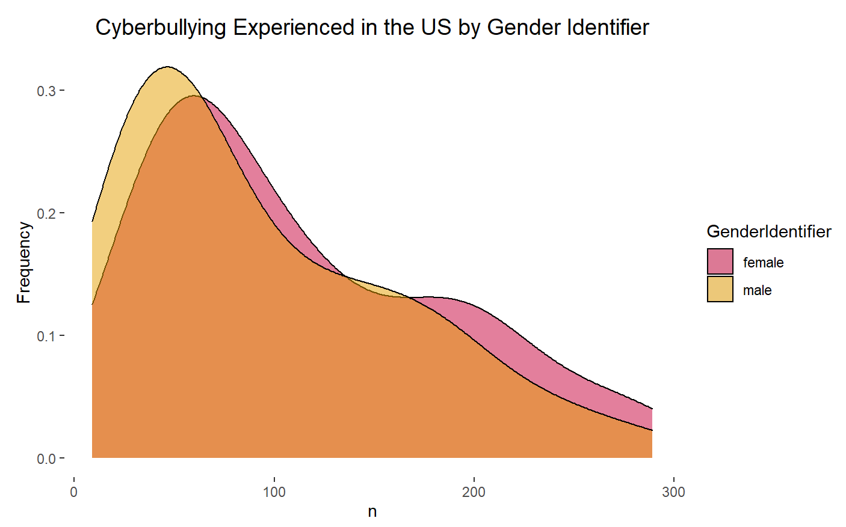

Slide 17

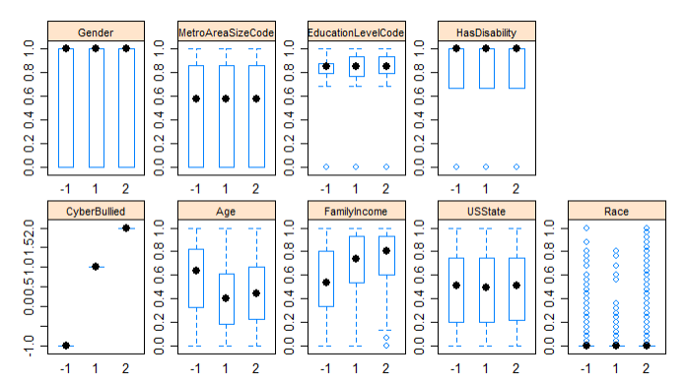

Slide 18


Slide 19


Slide 20


Slide 21


Slide 22


Slide 23


Slide 24
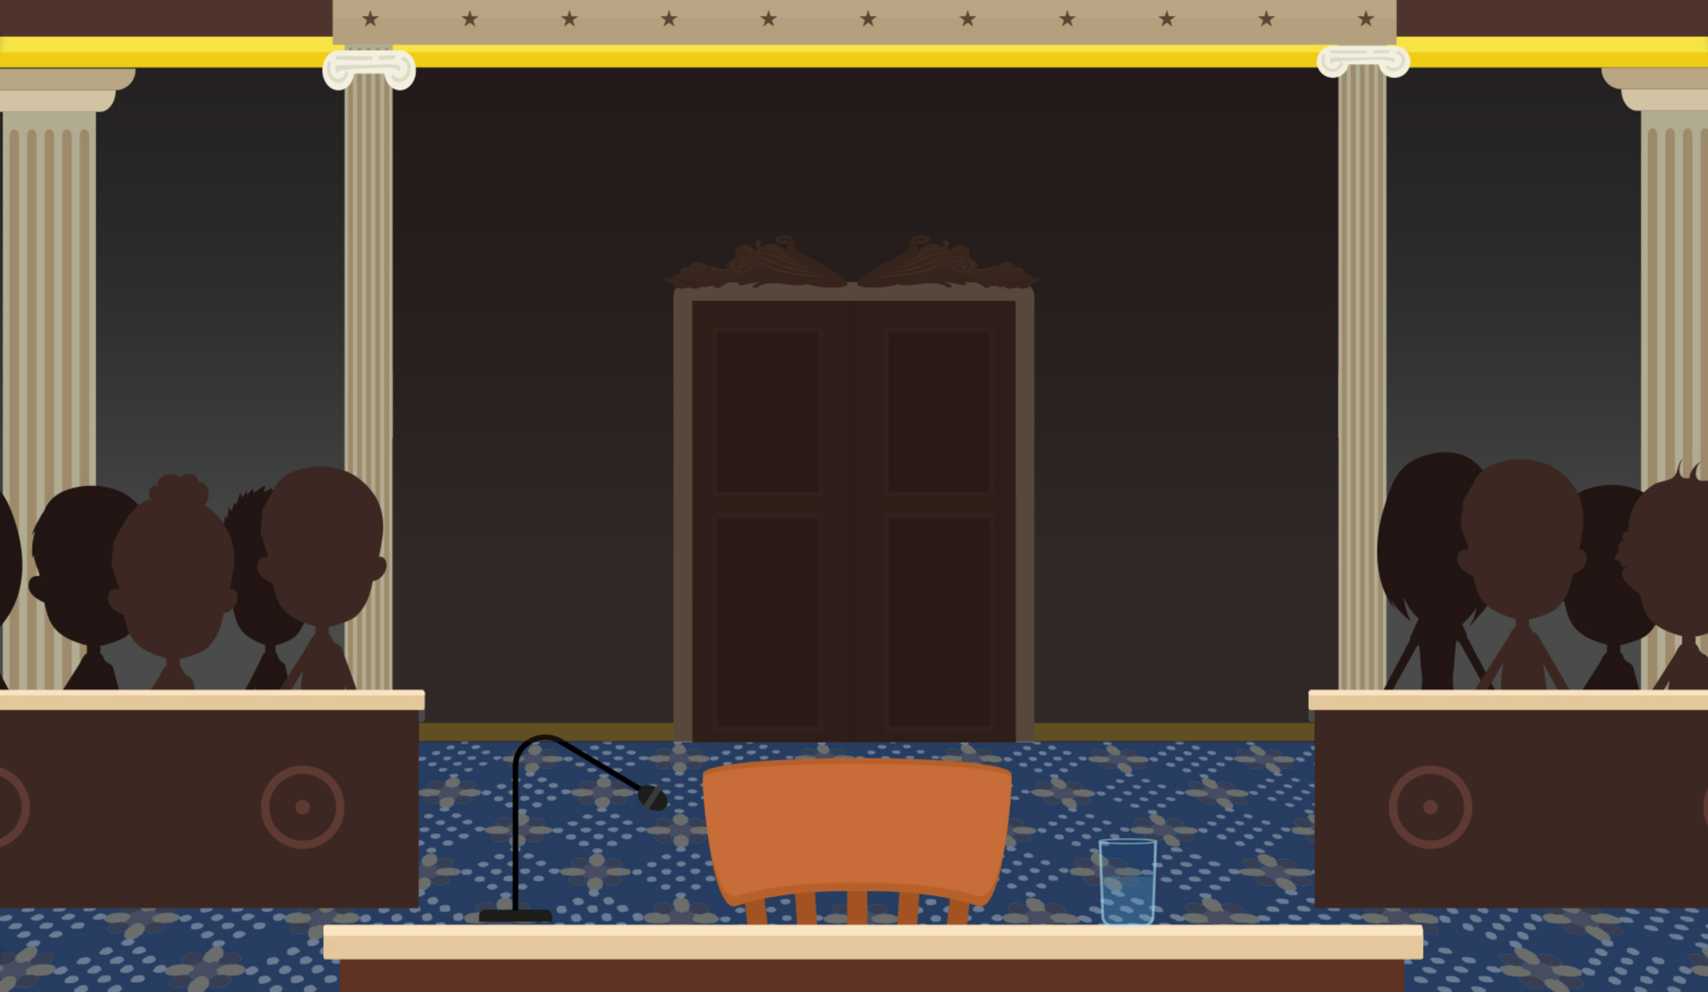

Slide 25


Slide 26
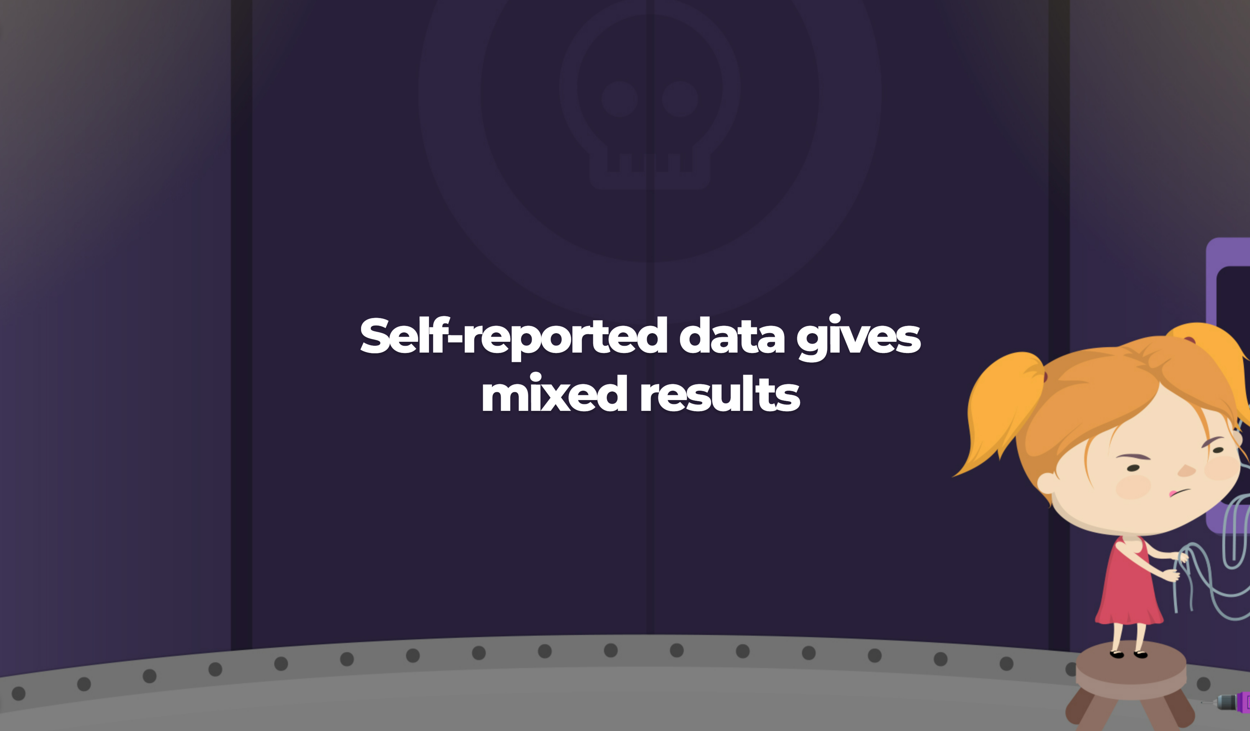

Slide 27


Slide 28
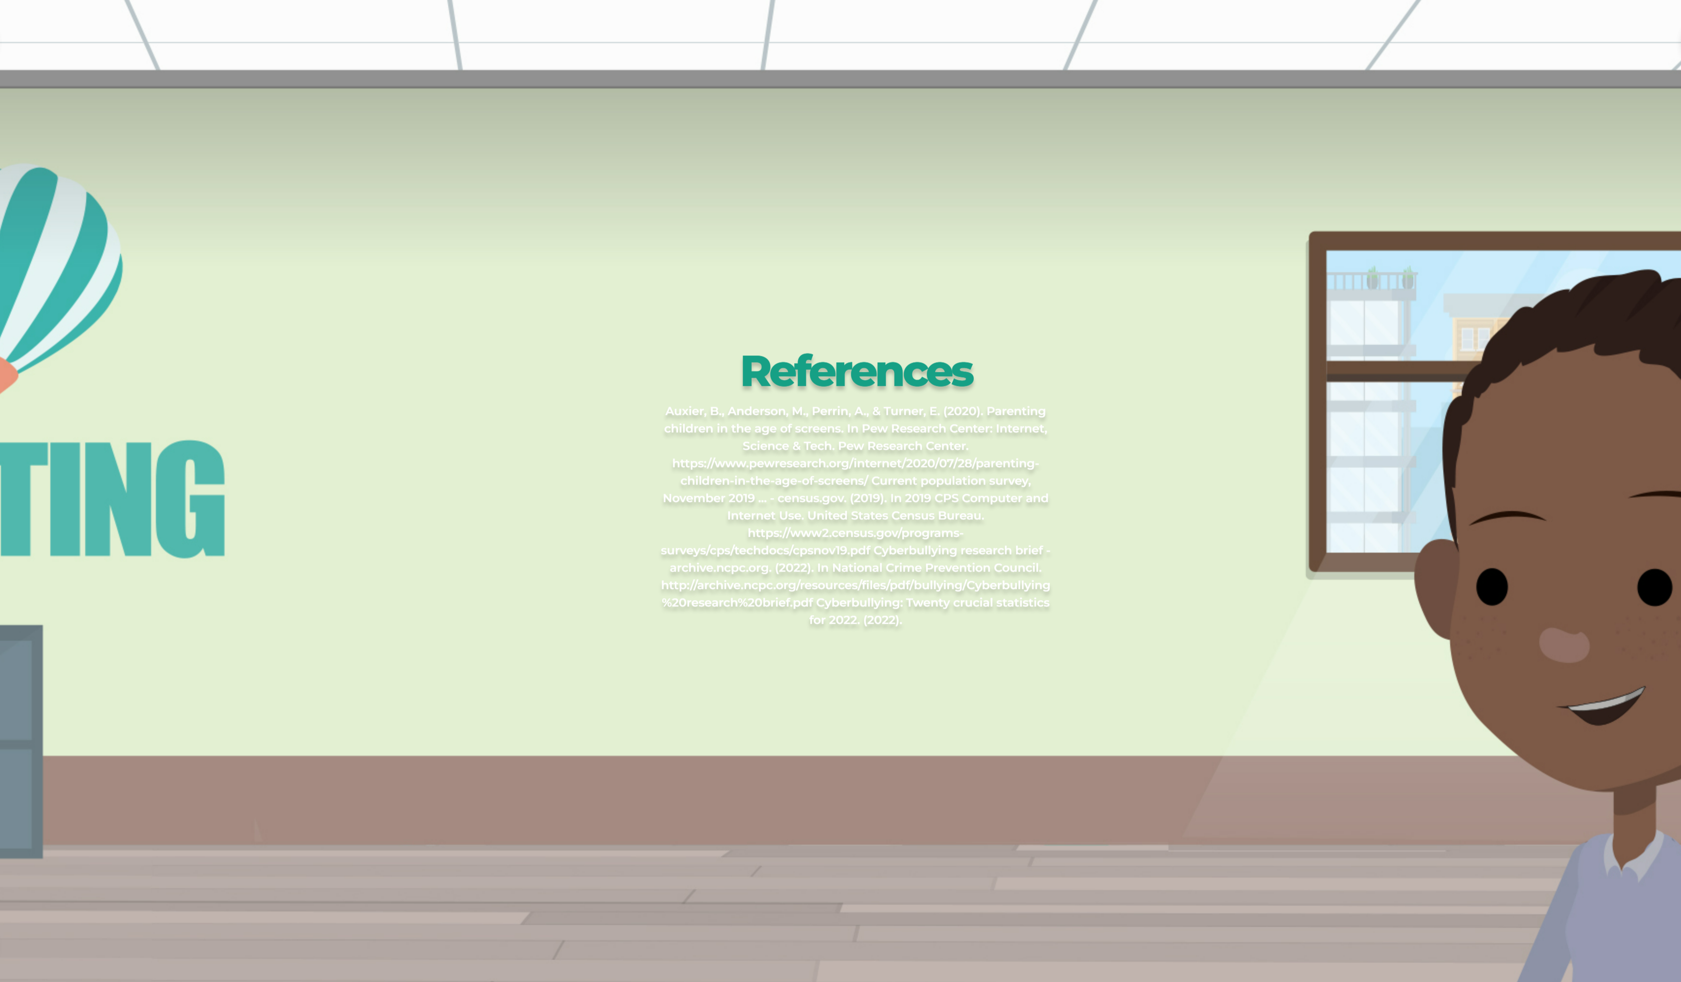

Slide 29
